Slide 1
2026 Open Enrollment
Your benefits, your well-being, your way - Discover more at Thrive.trilogyhs.com

Slide 2
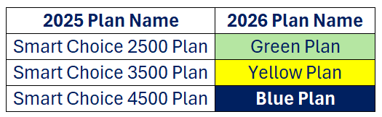
Agenda
Open Enrollment Info
3 Medical Plan Options:
Partners in your Health Plan
Who is Lucent Health and what do they do?
Who is 6 Degrees Health and what do they do?
What to do - Sample EOB
How to find care
Health Plan Enhancements
Dental and Vision
Disability and Life Benefits
Newly available benefit options- Accident and Critical Illness Insurance
401(k) Information

Slide 3
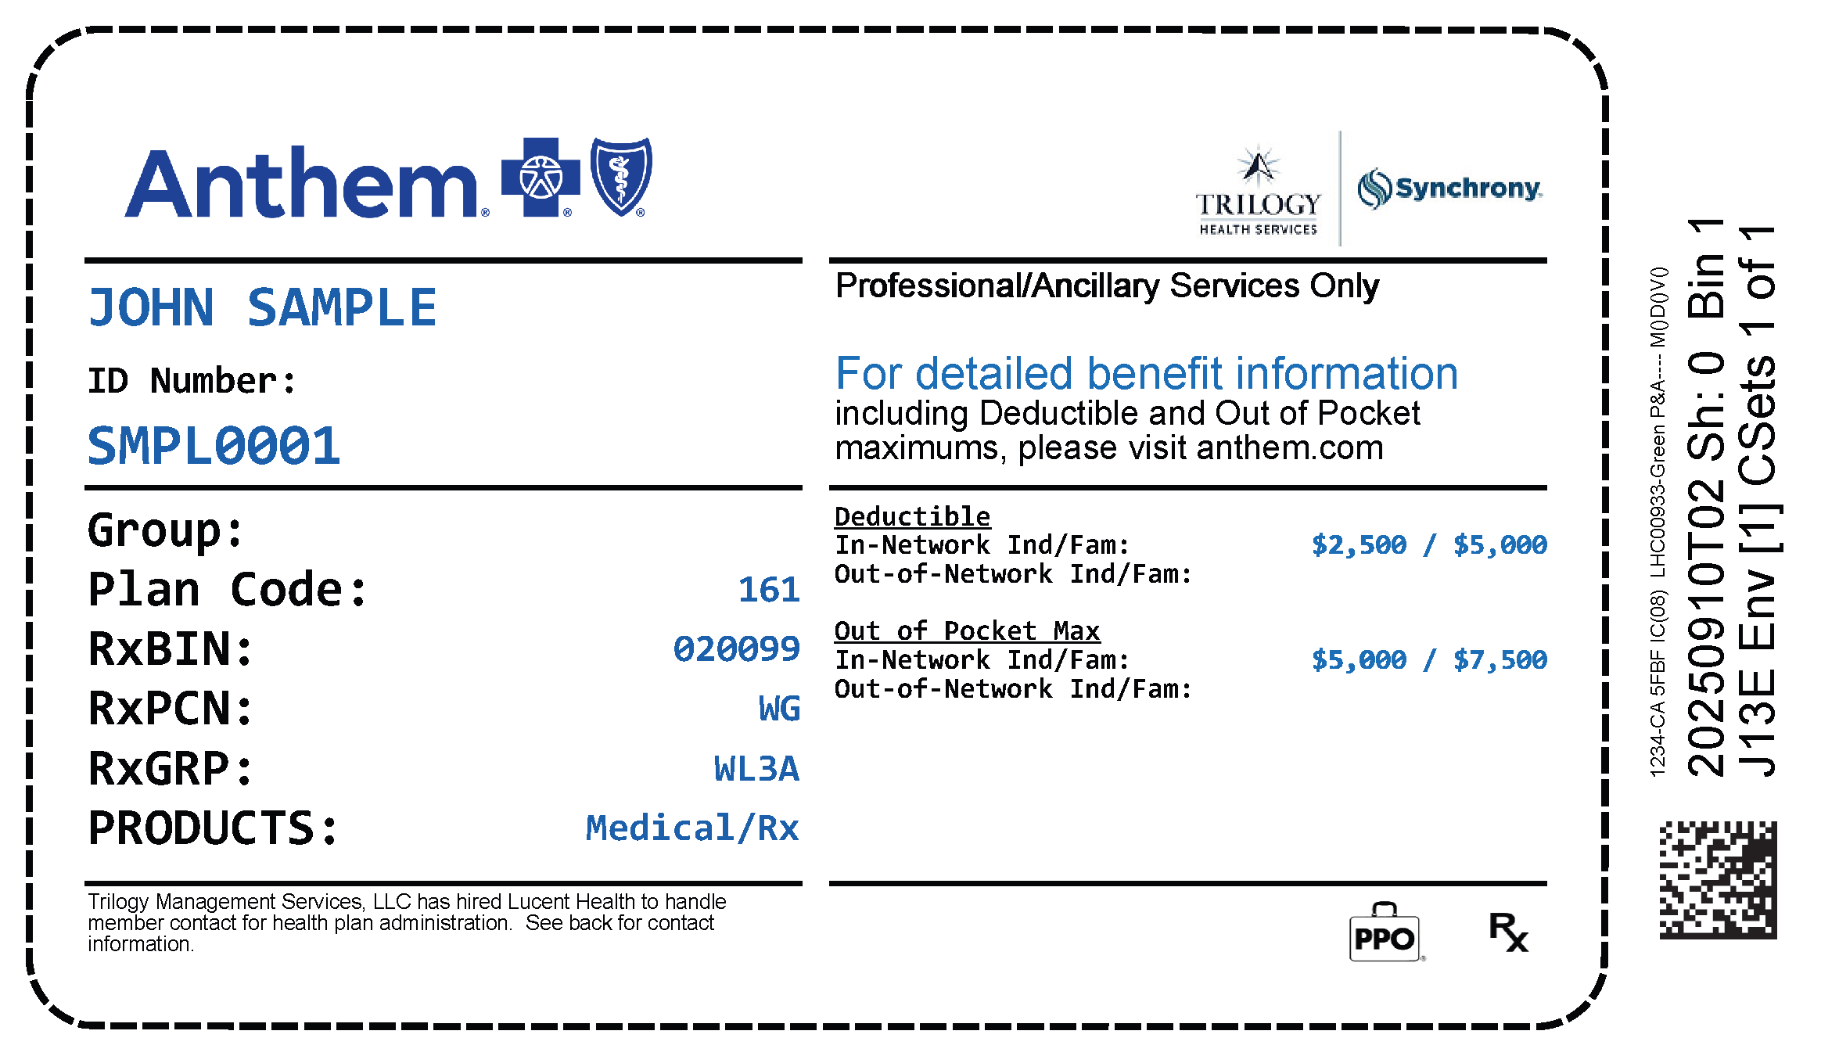
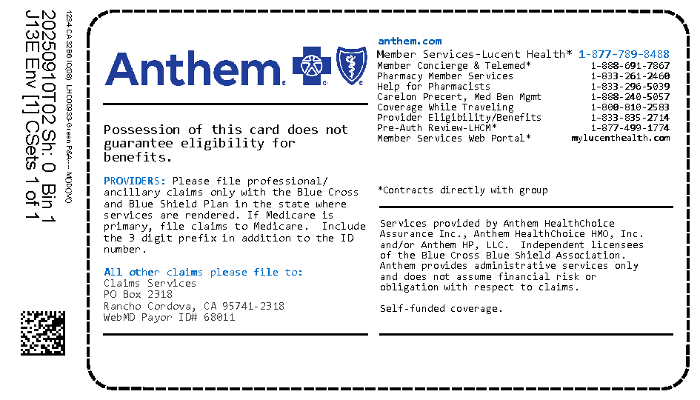
Open Enrollment
February 11th- February 18th
Enroll via INFOR or the INFOR GO mobile app
If you want benefits as of March 29, 2026, you must enroll
Contact the Trilogy Benefit Resource Center at 888-350-0532
New ID cards will be mailed to your address on file in Infor and will also be available digitally via the Lucent Health App
Medical and pharmacy benefits will be combined on a single ID card, shown below :

Slide 4
Green plan
What is different about the Green Plan?
The Green Plan has Open Access. This allows you to receive care from any provider (doctor or specialist), facility or hospital you choose without worry whether they are in or out of network.
      You can continue seeing your current Anthem providers, and/or
      You can also seek care with non-Anthem providers
      The cost for care is lower
How to confirm if your provider accepts your insurance under the Green Plan?
  Reach out to your provider to make an appointment, like normal, and provide your insurance information from your new ID cards.
  If they have questions, they can call the number on the back of your ID card.
  If you have questions, contact Trilogy’s Benefit Resource Center at
  888-350-0532.

Slide 5
Frequently asked questions about the Green Plan
1. How do I respond when my Physician asks, what insurance I have?
Your insurance is with Anthem.
2. Does the Green Plan have the Health Savings Account (HSA)?
Yes, all three plans have the HSA.
3. Why wouldn’t someone choose the Green Plan?
Everyone’s needs are different, and some may feel more comfortable with the traditional Yellow and Blue Plans.
4. Does the Green Plan have a deductible and out-of-pocket maximum (OOPM)?
Yes, the Green Plan has a $2,500 deductible for employee-only coverage and a $3,400 deductible per individual for employee + spouse, employee + children, or family coverage, with a $5,000 total deductible. The OOPM for the Green Plan is $5,000 for employee-only coverage and $7,500 for all other coverage options.
5. Is the Green Plan a high-deductible plan and does it have co-insurance once I meet my
deductible?
The Green Plan is a high-deductible plan, and the 80/20 coinsurance starts once you meet your deductible.
6. Can my dependents be covered on the Green Plan?
Yes. However, spouses can only be added to Trilogy insurance if their employer does not offer coverage.

Slide 6
Yellow Plan Blue Plan
Both the Yellow Plan and the Blue Plan provide the same access to Anthem in-network providers.
To keep cost as low as possible, you will need to seek care with an in-network provider, facility or hospital.
Costs will be higher if you seek care with an out-of-network provider, facility or hospital.
This is a similar plan to what you are used to.
The weekly premiums are higher.
How to confirm if your provider accepts your insurance under the Yellow Plan or Blue Plan?
    Contact the Benefit Resource Center (BRC) at 888-350-0532

Slide 7




Partners in your health plan
Benefits Resource Center
The administrator that manages the day-to-day operations of your healthcare benefits.
GREEN PLAN (OPEN ACCESS)
YELLOW PLAN
BLUE PLAN
They work behind the scenes to get you the lowest price
Use any provider (Anthem preferred) & any hospital or facility
Use Anthem’s In-Network providers & hospitals
Use Anthem’s In-Network providers & hospitals

Slide 8




what do they do?
Lucent Health is the administrator and works with 6 Degrees Health to process your health care claims accurately, promptly and at the lowest price.
If your provider does not accept your insurance, call the BRC. If they do, your Dr sends the bill to Lucent Health
Lucent Health confirms accuracy and works with 6 Degrees Health to obtain lowest price
Lucent Health remits payment to the Dr.
You receive an Explanation of Benefits (EOB) with the processed claim noting your portion of the bill

Slide 9
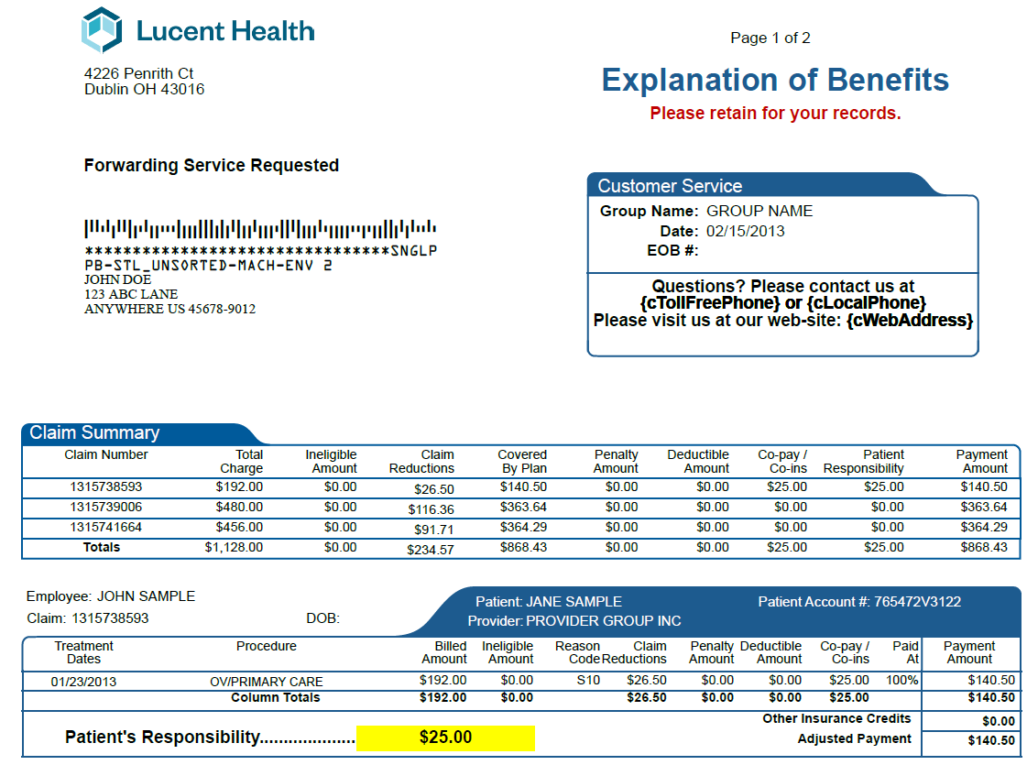
What to do - Sample EOB
Open all correspondence from your provider.
Compare the bill from your provider to the Explanation of Benefits (EOB).
If your EOB does not match the amount your provider is asking you to pay, call the BRC for assistance.
Call the Benefit Resource Center (BRC) at 888-350-0532 if you are needing any help and they will ensure you are connected with the right team of people to help you.

Slide 10
How to find care options
Anthem Physician/Provider/Doctor:
  Use this link:
  https://www.anthem.com/find-care/
  You must use TUG as your Member ID to search for a provider using this link. Do NOT use the numbers on your medical cards as they will not work.
  Input location by zip or address, and enter search criteria.
  You can search for Providers, Physicians, Facilities, and Hospitals.
What happens for out of network claims with the Green Plan?
Facility or Hospital:
  Select facility or hospital of your choice
  Lucent Health receives the claim
  6 Degrees Health is processed fairly before you receive Explanation of Benefit
Non-Anthem Physician or Provider:
  Lucent Health receives the claim
  6 Degrees Health makes sure your claim is processed fairly before you receive Explanation of Benefit
Need Help? Call the Benefit Resource Center (BRC) at 888-350-0532

Slide 11

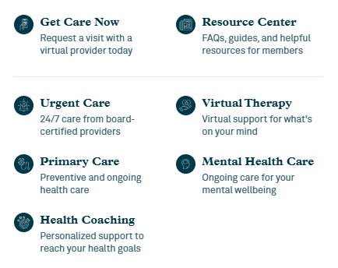
First Stop Health
Free Virtual Care with ALL medical plans
    Free virtual primary care visits
    Free virtual urgent care visits
    Free virtual behavior health
    Free disease management coaching
      Help manage weight
      Improve heart health
      Quit nicotine products
      Get better sleep
      Manage Diabetes
      And the best part is First Stop Health covers all household members, regardless of enrollment status!

Slide 12


Virta & Hinge Health
Employees who enroll in a Trilogy Health Plan also receive access to Virta and Hinge Health for FREE!
Virta
This program is available to medically enrolled employees and dependents with type 2 diabetes, prediabetes, or a BMI over 25 who are interested in safe, sustainable weight loss. Virta’s goal is to support participants in achieving their weight loss objectives, reducing medication use, and lowering overall healthcare costs.
Hinge Health
This program is a digital musculoskeletal clinic offering preventive care, acute and chronic therapy, and post-surgical recovery support. Hinge Health provides unlimited access to a team of licensed clinicians and specialists, including orthopedic surgeons, nurses, nutritionists, and board-certified health coaches. The program is offered at no cost to participants, with no copays and no need for in-person office visits.

Slide 13

Health Savings Accounts
Health Savings Account is administered through Bank of America:
  Employees have multiple options for their Kingston HSA:
      Roll over existing balances to Bank of America
      Maintain funds in the Kingston account (fees may apply)
      Spend down the account prior to March 29, 2026
Dollar-for-dollar company match:
      Up to $500 for Employee Only and Employee + Spouse coverage
      Up to $1,200 for Employee + Children and Family coverage
      Spread evenly over 52 pay periods
Employee contribution limits are:
      $4,400 for Employee Only coverage
      $8,750 for all other coverage levels
      If age 55+ during 2026, you may contribute an additional $1,000
Proper elections will help avoid tax complications:
      Employees are encouraged to contact the Benefit Resource Center (BRC) at 888-350-0532 for assistance with HSA contribution limits or questions
      Employees must account for any contributions made under Kingston HSA plans
      Employees must subtract employer contributions from the IRS maximum contribution limits
      Open enrollment contributions may be adjusted to adhere with IRS guidelines

Slide 14
Dependent Care Flexible Spending Account
The Dependent Care Flexible Spending Account (DCFSA) helps cover eligible child and elder care expenses for dependents. Eligible children must be under age 13. This program allows employees to pay for qualified care expenses using tax-free contributions, such as day care, summer camps, etc.
Families may contribute up to $7,500 per year to a DCFSA, or $3,750 per year for those who are married and file separately.
DCFSA funds are subject to the “use it or lose it” rule. Contributions may be used for eligible expenses incurred between March 29, 2026, and March 15, 2027. Claims for these expenses must be submitted no later than March 31, 2027.
Please note: Trilogy does not offer a Healthcare Flexible Spending Account (HCFSA). The DCFSA may only be used for eligible child and elder care expenses.

Slide 15
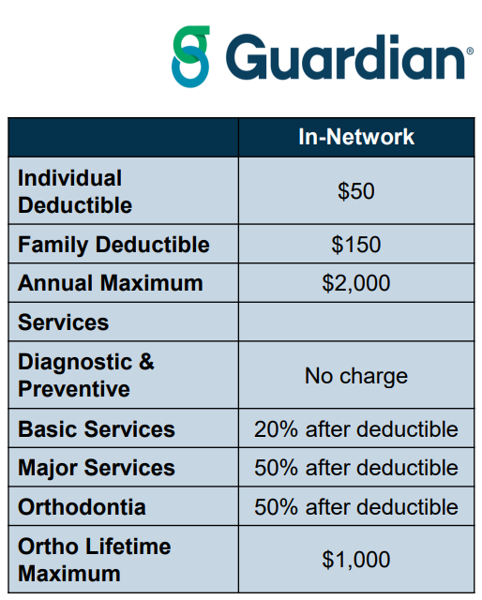
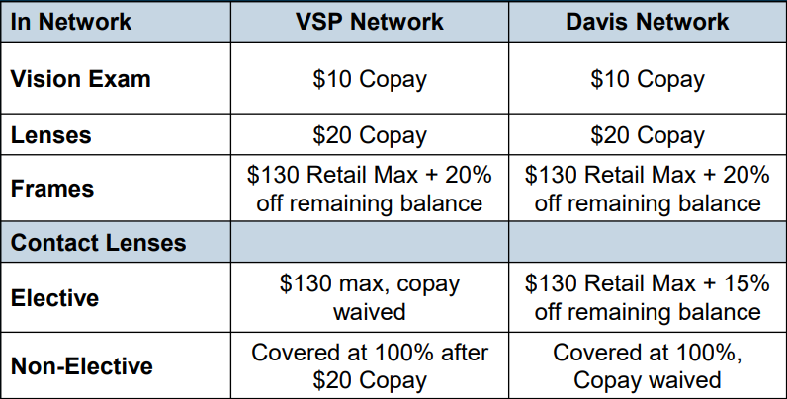
Dental & Vision
Trilogy’s dental plan offers lower premiums and increased annual maximum, doubling from $1,000 to $2,000 per year.
Premiums are based on an employee only, Employee + One or a Family coverage.
Trilogy’s vision plan offers access to two provider networks, allowing employees to choose between VSP or Davis.
Lower premiums across all coverage levels, which are structured as Employee Only or Family coverage.

Slide 16

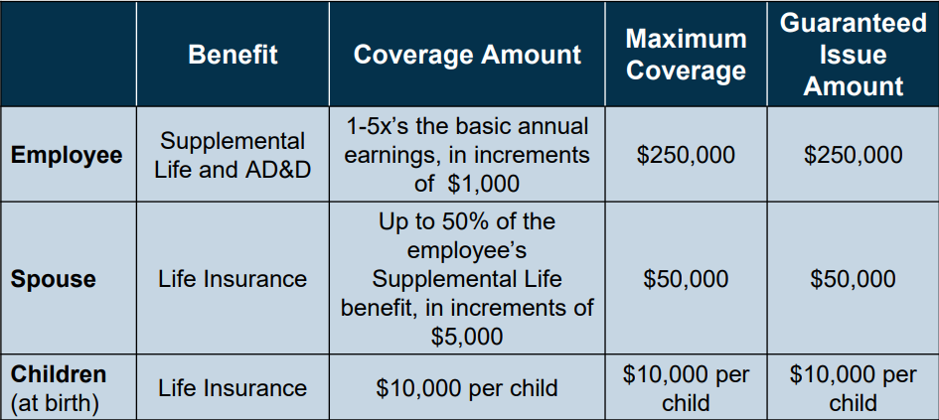
Voluntary Life and AD&D
Employees are not subject to health questionnaires when benefits are elected upon hire.
Please keep in mind, benefits have the following age reductions:
  35% at age 65
  60% at age 70
  75% at age 75
  85% at age 80
  VPs and above may contact the Benefit Resource Center for additional information.
Need Help? Call the Benefit Resource Center (BRC) at 888-350-0532

Slide 17
Short- and Long-Term Disability
Trilogy offers employees the option of BOTH Short- and Long-Term Disability.
Short Term Disability
60% if your weekly pre-disability earnings
Maximum: $750 per week
Benefits begin : After a 14-calendar day waiting period
Benefits end: After up to 24 weeks
Long Term Disability
60% of your monthly income
Maximum: $10,000 per month
Benefits begin: On the 181st calendar day of absence
Benefits end: Up to five years of a non-work-related accident of sickness

Slide 18
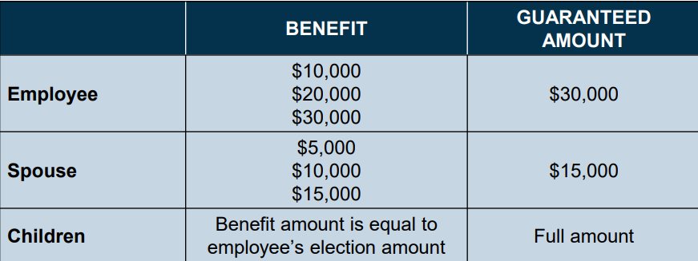
Accident and Critical Illness Insurance
What are these brand-new benefits and what can they do for me?
Accident Insurance provides an additional layer of financial protection by offering a cash benefit to help cover out-of-pocket expenses when a qualifying, unexpected accident occurs. Examples of covered events may include emergency room treatment, ambulance services, burns, dislocations, fractures, hospital confinement, broken bones, and surgery. Click here to learn more!
Critical Illness (CI) Insurance pays a lump-sum benefit if you or an eligible dependent is diagnosed with a covered illness or condition. CI includes benefits for over 30 major illnesses Including cancer, heart attack, stroke, and kidney failure. Click here to learn more!

Slide 19
401 (K) Information
Trilogy partners with Bank of America (BofA) for their 401(k).
Effective 07/01/2026 all Kingston employees hired before 03/01/2026 will auto-enroll at 3% pre-tax contribution unless you contact BofA to select differently.
After 03/29 BofA will send information directly by mail to all Kingston employees with information pertaining to auto-enrollment and the ability to change contributions and/or OPT out.
Employes hired on or after 03/01/2026 will begin autoenrollment at 90-days from their hire date following the same procedures on how to change or OPT out of the program.
Company Match: $0.25 for every $1.00 contributed, up to 10% of eligible weekly pay. The employer match applies to both pre-tax and post-tax (ROTH) deferrals and is credited to the 401(k) account on a weekly basis.
Company Match: $0.25 for every $1.00 contributed, up to 10% of eligible weekly pay. The employer match applies to both pre-tax and post-tax (ROTH) deferrals and is credited to the 401(k) account on a weekly basis.
Vesting: Company contributions are subject to a vesting schedule; however, your Kingston tenure is recognized and applied toward this vesting schedule:
      After 1 year of employment- match is 20% vested
      After 2 years of employment- match is 40% vested
      After 3 years of employment- match is 60% vested
      After 4 years of employment- match is 80% vested
      After 5+ years of employment- match is 100% vested
Additional details will be provided as the enrollment date approaches.

Slide 20

Any Questions?
Call the Benefit Resource Center (BRC) at 888-350-0532

